Slide 1
Calculating KE and GPE

Slide 2
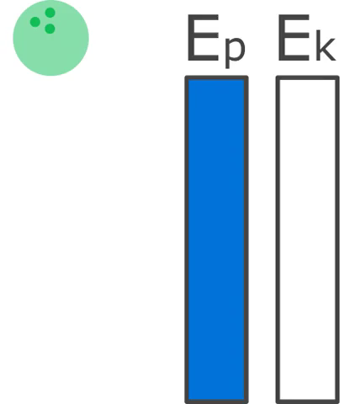
In this Smart Lesson you will learn to:
Solve problems involving kinetic energy and gravitational potential energy.

Slide 3


Gravitational potential energy (GPE) is energy stored in an object due to its position (height).
We can calculate gravitational potential energy from the following formula:

Slide 4

There are three factors that the gravitational potential energy depends on. These are:
• | Mass
• | Acceleration due to gravity
• | Height
Mass is represented by m in the formula below, acceleration due to gravity is represented by g, and height is given by h.

Slide 5

You may be wondering what the Δ symbol means. This symbol is called delta, and it represents change.
In this formula, it means that there is only a change in gravitational potential energy if the object's height changes (assuming that the mass remains the same).

Slide 6

When you are doing calculations, it is very important that you use the right units.
The unit for mass is the kilogram (kg).
The unit for height is the metre (m).
The unit for energy is the joule (J).
Acceleration due to gravity is a constant, so it is always:

Slide 7

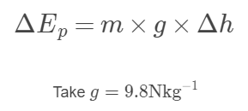
Let's look at an example.
A cat with a mass of 5kg climbs 2m up a tree. What is the change in the cat's gravitational potential energy?
Use the formula:

Slide 8
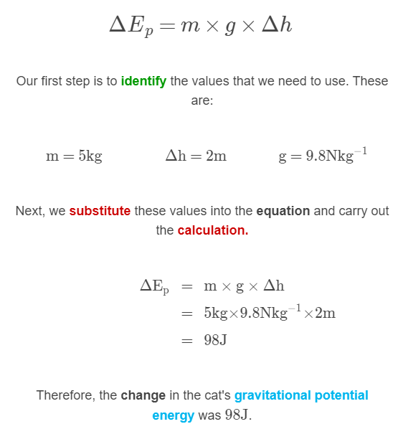

Slide 9
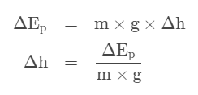
Sometimes we need to find an object's change in height from its gravitational potential energy.
We do this by rearranging the equation for gravitational potential energy.
All we have to do here is divide both sides of the original equation by m and g.

Slide 10
Worked example for calculating height from GPE.
Sophie is bouncing on the trampoline. She has a mass of 60kg and her change in gravitational potential energy between her highest and lowest points is ΔE_{p}​=900J.
To find Sophie's change in height between her highest and lowest points, we rearrange the equation for gravitational potential energy and substitute the values we are given into the equation.

Slide 11
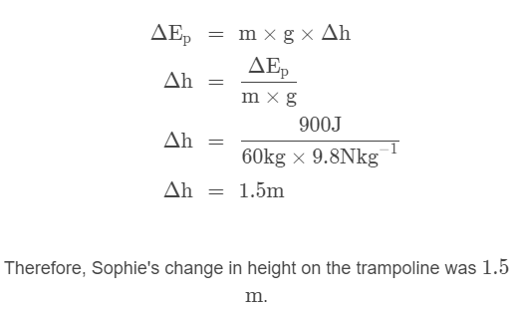

Slide 12

We may also want to find an object's mass from its gravitational potential energy.
To do this, we rearrange the equation for gravitational potential energy. We do this by dividing both sides by height and acceleration due to gravity.

Slide 13
Worked example for calculating mass from gravitational potential energy.
An eagle takes off and flies. Its change in height during the flight was 200m and its change in potential energy was 8000J.
To find the eagle's mass, we rearrange the equation for gravitational potential energy and substitute the values we are given into the equation.

Slide 14
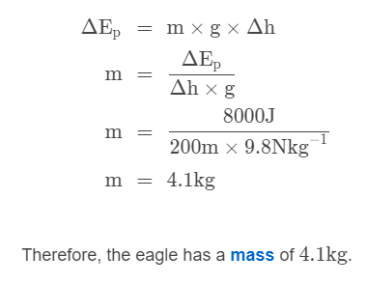

Slide 15
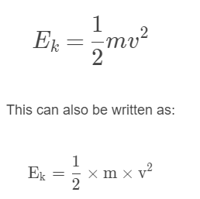
Kinetic energy is calculated by using this formula:
In this formula, E_{k}​ represents kinetic energy, m represents mass, and v represents speed.

Slide 16


In this formula, we see that kinetic energy is proportional to mass and proportional to speed squared.
This means that when the mass of an object doubles, the kinetic energy also doubles. However, when the speed doubles, the kinetic energy gets four times larger.

Slide 17

What units are used in this formula?
When we use this formula, the mass must be in kilograms (kg) and the speed must be in metres per second (ms₋₁).
This gives the kinetic energy in joules.

Slide 18
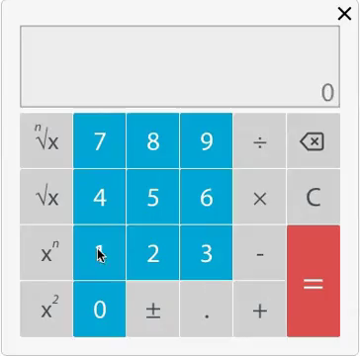
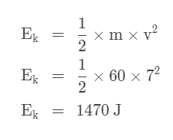
Worked example calculating kinetic energy.
A jogger has a mass of 60 kg and is travelling at a speed of 7 ms⁻¹. To find the jogger's kinetic energy, we substitute these values into the kinetic energy formula:

Slide 19
Sometimes you will be given the kinetic energy of an object and asked to find the speed at which it is travelling.
We can find this by rearranging the formula we use to calculate kinetic energy.

Slide 20

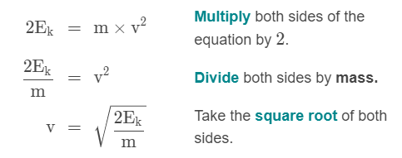
The formula for kinetic energy is:
To find speed, we need to make v the subject of this equation. Here's how we rearrange this equation:

Slide 21
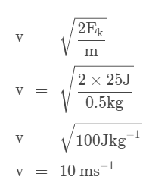
Worked example calculating speed or velocity from kinetic energy.
A soccer ball has a kinetic energy of 25J. What speed of the ball if its mass is 0.5kg?
To solve this problem, we take our rearranged formula and substitute in the values for kinetic energy and mass.

Slide 22
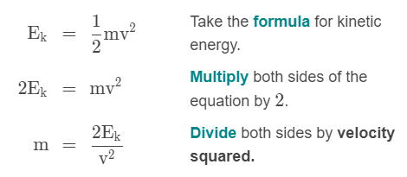
We may also want to find the mass of an object.
We can also do this by rearranging the formula for kinetic energy.
To find mass, we need to make m the subject of this equation. Here's how we rearrange this equation:

